Slide 1
R-language

Slide 2
Agenda
Introduction to R
Data Handling in R(Data Type)
Installing a package / setting up working directory

Slide 3
Introduction to R
R is DSL (Domain Specific Language) and here domain is STATISTICS
Open Source statistical language
De Facto standard for statistical research across academia and corporates
Dialect of S language, influenced by Scheme and Fortran
S was developed at Bell Labs with primary focus on internal statistical analysis and originally implemented as Fortran libraries
Re-written with C in 1988
It’s FREE!!! With free software, you are granted:
Freedom 0: To run the program, for any purpose
Freedom 1: To study working of program and tweak it to suit your requirements by accessing source code
Freedom 2: To redistribute copies
Freedom 3: To improve the program and to release your improvements to the public

Slide 4
The Good thing of R
Statistical functions are easily accessible
Convenient manipulation of tables
Vector operations
Smooth handling of missing data
Interactivity for data analysis
Open source, interpreted and portable

Slide 5
History and Evolution of R
First announcement of R to the public
Public mailing lists are created
(R-help and R-devel)
Release of R 1.0.0
1993
1996
2000
2004
Release of R 2.0.0
1991
1995
1997
2013
Created at The University of Auckland, New Zealand by Ross Ihaka and Robert Gentleman
Martin Machler convinces Ross and Robert to use the GNU General Public License to make R free software
The R Core Group is formed to control source code of R
Release of R 3.0.2
2016
Release of R 3.2.3

Slide 6
Setting up R and IDEs (RStudio)
Please find the following links to download and install *Anaconda And R*.
*For R:-* https://www.andrewheiss.com/blog/2012/04/17/install-r-rstudio-r-commander-windows-osx/
Or watch video for guidance - https://www.youtube.com/watch?v=9-RrkJQQYqY (windows)
https://www.youtube.com/watch?v=EmZqlcKkJMM (mac)

Slide 7
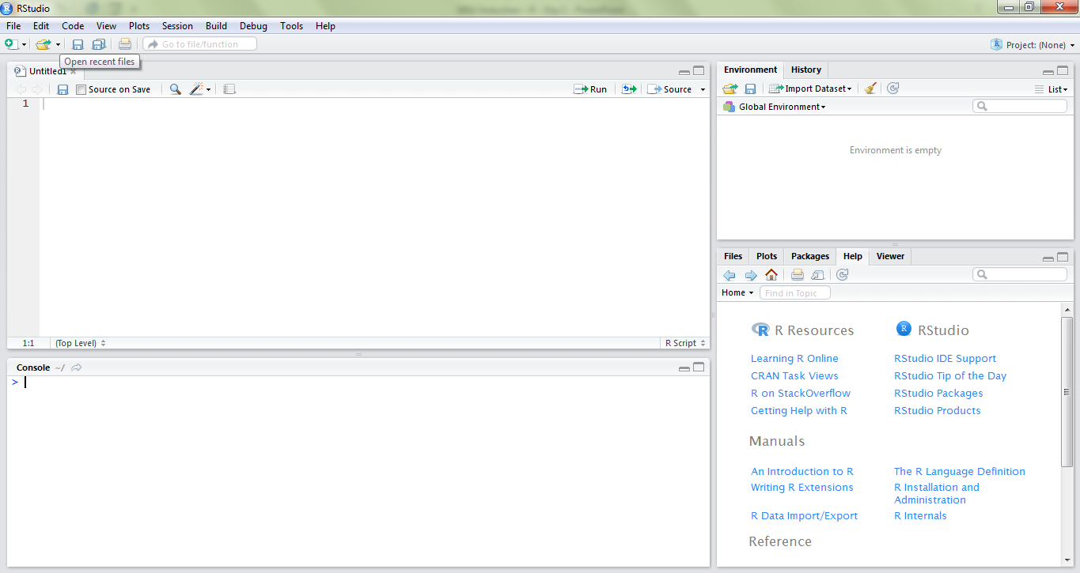
RStudio
Editor
Workspace
Console
Help and Plot

Slide 8
Case – sensitivity of R
R is case – sensitive, hence ‘x’ is not same as ‘X’
All object or function declarations should be done considering this constraint
The function “c” coerces all the elements into a vector
Function calls with incorrect casing will also throw an error
# Declaring vector x
x <- c(1,2,3,4,5,6)
> x
[1] 1 2 3 4 5 6
> max(x)
[1] 6
> X
Error: object ‘X’ not found
> Max(x)
Error: could not find function “Max”

Slide 9
Operators in R
Arithmetic Operators
> 5 + 7 #Try out other simple operators
[1] 12
> 23 / 5 #Division
[1] 4.6
> 23 %% 5 #Finding out remainder
[1] 3
> 23 %/% 5 #Finding out quotient
[1] 4
> 3 ^ 2
[1] 9
> 3 ** 2
[1] 9
Operator | Description
+ | Addition
- | Subtraction
* | Multiplication
/ | Division
%% | Modulus
%/% | Quotient (Integer Division)
^ or ** | Exponentiation
> v1 <- c(1,2,3,4,5)
> v2 <- c(6,7,8)
> v1 + v2
[1] 7 9 11 10 12

Slide 10
Operators in R
Relational Operators
> 5 > 7
[1] FALSE
> 5 <= 7
[1] TRUE
> v1 <- c(1,2,3,4,5)
> v2 <- c(1,0,3,0,5)
> v1 == v2
[1] TRUE FALSE TRUE FALSE TRUE
> y1 <- c(1,2,3,4,5)
> y2 <- c(1,0,3,0,5)
> y2 <= y1
[1] TRUE TRUE TRUE TRUE TRUE
Operator | Description
< | Less Than
<= | Less Than or Equal To
> | Greater Than
>= | Greater Than or Equal To
== | Exactly Equal To
!= | Not Equal To

Slide 11
Operators in R
Logical Operators
> !(5 == (10/2))
[1] FALSE
> a <- c(FALSE, TRUE, FALSE, TRUE)
> b <- c(FALSE, FALSE, TRUE, TRUE)
> a & b
[1] FALSE FALSE FALSE TRUE
> a | b
[1] FALSE TRUE TRUE TRUE
> x <- c(FALSE, TRUE, TRUE, FALSE)
> y <- c(TRUE, TRUE, TRUE, FALSE)
> x && y
[1] FALSE
Operator | Description
! | NOT
isTRUE(x) | Checks if ‘x’ is TRUE
& | Element wise AND
| | Element wise OR
&& | AND
|| | OR
xor(X,Y) | XOR

Slide 12
Operators in R
Assignment Operators
> a <- 1:10
> a
[1] 1 2 3 4 5 6 7 8 9 10
> b = 1:4
> b
[1] 1 2 3 4
> mean(x <- 1:10)
[1] 5.5
> mean(x = 1:8) #Observe the value of x
[1] 4.5
> mean(a <- 1:5)
[1] 3
> mean(a = 1:5)
Error in mean.default(a = 1:5) : argument "x" is missing, with no default
Operator | Description
<- | Left Assignment Operator
= | Similar to Left Assignment, but works only at top level
-> | Right Assignment Operator

Slide 13
Agenda
Introduction to R
Data Handling in R(Data Types)
Installing a package / setting up working directory

Slide 14
Data Handling in R
R Atomic Data Types
R Data Objects
Data Type | Example
Logical | TRUE/FALSE, 1/0
Integer | 12L, 9L
Numeric | 1.2, 200, 54
Character | “a”, “Hello”, “TRUE”, “23.4”
Data Objects | Dimensions | Notes
Vector | 1 dimensional | All elements must have the same data type
Matrix | 2 dimensional
Data Frame | 2 dimensional | Each column can have different data type
Factor | 1 dimensional | Stores vectors along with the distinct values of elements as labels
List | Multi-dimensional | Combination of different data types and data objects
Converting data types – as.numeric(), as.character()…
Checking data types – is.numeric(), mode(), typeof(), class()

Slide 15
Agenda
Introduction to R
Data Handling in R(Data Types)
Installing a package / setting up working directory

Slide 16
Installing packages
Packages are collection of functions and objects designed to perform a specific task
Installing packages can be done with command – install.packages(“package-name”)
Once package is installed, it can be loaded using command – library(package-name)
Version incompatible packages can be downloaded in the form binary files from CRAN repository, and then can be directly extracted into package directory of R
# Installing package
install.packages("plyr")
# Loading package
library(plyr)
# Checking whether package is installed or not, before installing it
if (!require("plyr"))
install.packages("plyr")

Slide 17
Setting up working directory
What is working directory?
An absolute default file path for R to read and write
R stores .Rdata files and History to this default location
Can be changed as per requirement
Basic structure of working directory
Input
Script
Output
# Getting working directory
getwd()
# Setting working directory
wd.path <- “D:\\MSU\\R\\”
setwd(wd.path)
> getwd()
[1] "C:/Users/firstname.lastname/Documents"
Notice the “/” (front slash) in the path command instead of the regular “\” (back slash)

